Slide 1

Data Augmentation for Road Sign Detection
Francesco Azzoni, Corrado Fasana, Samuele Pasini

Slide 2
Analyzed papers
Zhu et al. – Emotion Classification with Data Augmentation Using Generative Adversarial Networks [Zhu2017]
Zhang and Zhou - ECycleGAN: Enhanced Cycle-Consistent Generative Adversarial Networks [Zhang2020]
Jackson et al. - Style Augmentation: Data Augmentation via Style Randomization [Jackson2019]

Slide 3
Zhu2017
They propose an adversarial augmentation technique in order to balance the emotion dataset using domain transfer
They use CycleGAN to build the framework
LSGAN is used as adversarial loss

Slide 4
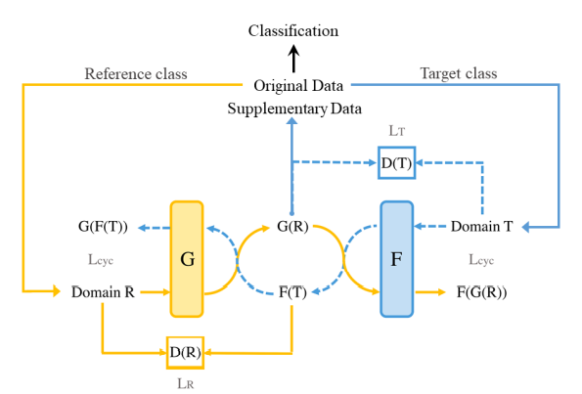
CycleGAN

Slide 5



CycleGAN in emotion classification

Slide 6
Results
There is an improvement in distribution integrity and margin clarity between classes
Accuracy of emotion classification task increases significantly

Slide 7
Zhang2020
They modify CycleGAN in order to improve the quality of the generated images
They show superiority in domain translation (not specifically in emotion classification)
The introduced model is named ECycleGAN

Slide 8
CycleGAN vs ECycleGAN
CycleGAN
ECycleGAN
Residual blocks as the basic network building unit
LSGAN as the adversarial loss
Cycle consistency based on low-level pixel-wise error measures (pixel similarity)
Residual Dense Normalization Block
WGAN-GP as the adversarial loss
Cycle consistency based on features extracted from a VGG19 network (perceptual similarity)

Slide 9
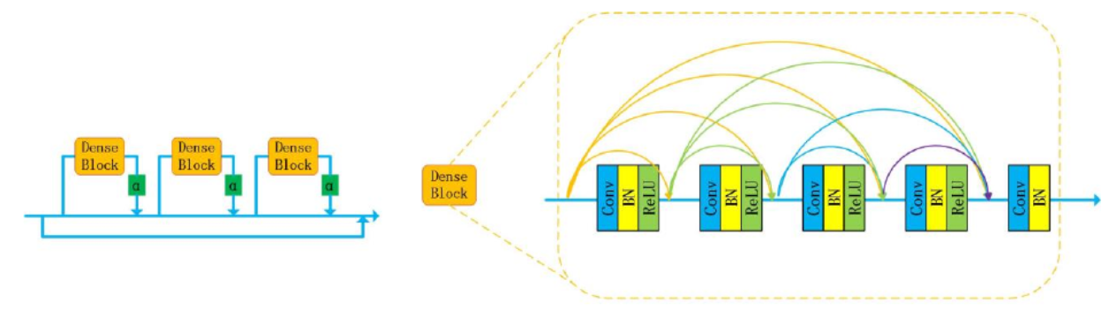
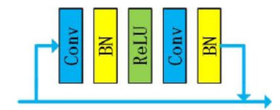
CycleGAN vs ECycleGAN
RDNB
Residual block

Slide 10


CycleGAN vs ECycleGAN
Pixel Similarity
Perceptual Loss

Slide 11
Our Idea
Exploit ECycleGANs to balance a dataset of road signs (some of which are less frequent than others).
Use a classifier to evaluate and compare results obtained with and without data augmentation.

Slide 12
Work Plan
Domain transfer on emotion classification
Implement a basic classifier to evaluate
Emotion classification accuracy without augmentation (FER 2013)
Use CycleGAN for emotion classification, replicating experiment of Zhu2017
Implement ECycleGAN and train on emotion classification dataset to balance it
Use the basic classifier to evaluate
Emotion classification accuracy with augmentation from CycleGAN
Emotion classification accuracy with augmentation from ECycleGAN
Domain transfer on traffic sign – next step

Slide 13
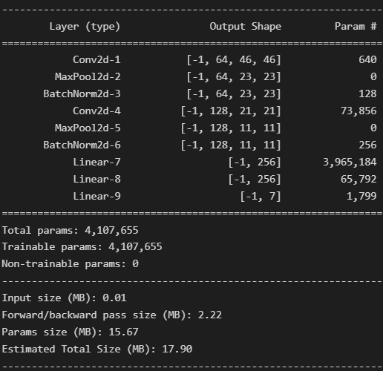
Basic classifier
The basic classifier purpose is not to obtain the best possible result, but to show how the augmentation improves potentially the result.
The implemented architecture is shown on the right.
We also tried the architecture proposed in Zhu2017 as basic classifier, but the obtained results were far worse than the declared ones and also worse that the obtained ones with our basic architecture.

Slide 14
Dataset – FER2013
The dataset used in the experiment is FER2013, the one used in Zhu2017.
The dataset is highly unbalanced, there are 35887 images in 7 classes, but the samples in “Happy” class are 8989 and samples in “Disgust” class are 547.
Given the idea to balance the dataset, we sampled the same number of images (100) for every class as test set, having a test set with 700 images.
The results of the basic classifier without augmentation are shown at the end to have an easier comparison with the augmented experiments.

Slide 15
CycleGAN experiment
Starting from the official implementation of CycleGAN:
https://github.com/junyanz/pytorch-CycleGAN-and-pix2pix
We modified the network to obtain the architecture proposed in Zhu2017.
We trained the CycleGAN for 150 epochs in 2 different tasks using the hyperparameters proposed in the paper:
From Neutral to Disgust
From Neutral to Sad

Slide 16


Qualitative evaluation
From a qualitative point of view, the obtained images are not very good:
They are worse than the ones reported in Zhu2017.

Slide 17
ECycleGAN experiment
Starting from our implementation of CycleGAN, we extended the architecture to the one proposed by Zhang2020.
The main changes are:
Introduction of perceptual loss
Introduction of RNDB blocks
Introduction of WGAN-GP
We faced different problems during the training of ECycleGAN, in particular we used a simpler architecture with respect to the one proposed by Zhang2020 because of our hardware limitations and trained the model on the task Neutral-Disgust for a limited amount of epochs (50).
We also used LSGAN (the one used by CycleGAN) instead of WGAN-GP because the latter did not seem effective during the training.

Slide 18
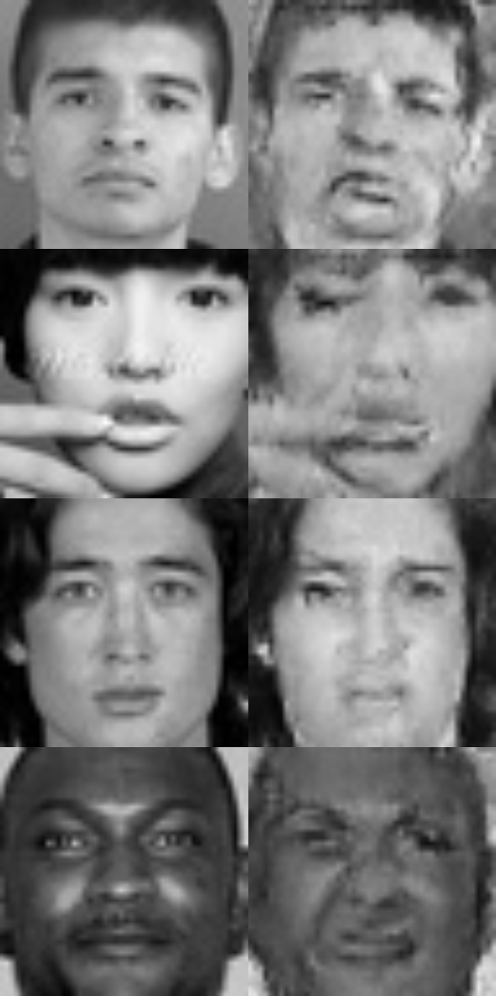
Qualitative evaluation
From a qualitative point of view, the obtained images are better than the ones obtained in CycleGAN experiment:
They are still slightly worse than the ones reported in Zhu2017.

Slide 19
Classifier training
Using the basic classifier built before, we performed training using:
FER2013 Dataset
FER2013 Dataset augmented with Disgust Images from CycleGAN experiment
FER2013 Dataset augmented with Disgust Images from ECycleGAN experiment
Augmentation with Sad images is not reported because it does not have a counterpart for the ECycleGAN experiment

Slide 20
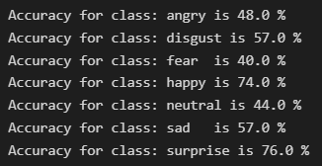
Quantitative evaluation

Slide 21
Thanks for the attention!

